Slide 1


Slide 2

OOW (Order Of Water)
FYP proposal by
FAWAD AHMAD 2018-GCUF-070332
AHMAR TARIQ 2018-GCUF-070316
SOHAIL ASGHAR 2018-GCUF-070354
Bachelor of sciences
In
Computer Science
Government college university Faisalabad

Slide 3
Table of Content
What is OOW (order of water)?
Benefits
Goals
Objectives
Features
Scope

Slide 4
What is OOW (Order Of Water)?
The order of water (OOW) project is aimed at developing or building an online search portal for water orders at any place and at any time. In this portal, different organizations, institutions, etc. request/demand water according to their requirements so that people of all kinds will be able to order the purified water at their doorstep

Slide 5
Benefits of OOW (Order Of Water)
Faster buying process.
Cost reduction.
Flexibility for customers.
No reach limitations.
Product and price comparison.
Faster response to buyer/market demands.
Several payment methods.

Slide 6
Goals of OOW (Order Of Water)
Optimize product pages for search engines.
Capture leads through social media.
Collect email leads through signup forms.
Boost sales through upselling and cross-selling.
Reduce abandoned carts.
Build customer loyalty.

Slide 7
Objectives of OOW(Order Of Water)
Selling goods to the buyers or consumers.
Maintaining/fulfilling a contract with a current customer.
Getting customers’ assistance for the promotion of a product line.
Looking out for new customers.
Providing any possible technical assistance to a customer to use a technical product smoothly.

Slide 8
Features of OOW (Order Of Water )
Mobile-friendly, responsive design.
High-quality images.
User-friendly navigation, search.
FAQ section.
Display inventory availability in real-time
Always display accurate pricing
Provide customized payment conditions
Edit orders even after they’re placed
24/7 client focus

Slide 9
Scope of OOW (Order Of Water)
Exchange of digitized information
Technology-enabled
Customers retention
Data Store
Supplier integration
Support the exchange

Slide 10
Motivation
We were inspired to create this app since I like to purchase online rather than spend a lot of time in physical Places. Also, in producing and selling things through current shops, there is the possibility of developing one's own customized online store application from the scratch, as custom designed platforms are expensive. Additionally, I value my current knowledge of the FLUTTER (DART) and FIRE BASE as backend programming languages, as well as understanding how strong and dynamic they are when it comes to an Mobile App form.

Slide 11
Purpose
In this global generation, everyone is attached to the internet everyone wants to do work with the help of their mobile phones and the internet even the smallest work.
So the app will be made by especially for this purpose that the people will order the water with the help of their mobile phones and the internet. Because to order water by going to the filtration place is very time-consuming and difficult work but the modern era and modern technology will help us to save our time and get us to ride off that kind of problem.
Fortunately, there are several ways people can get filtered water. A water filter has microscopic holes that remove sediment and pollutants from the water. The smaller the holes, the less it allows passing through and the cleaner the water is. The way each type of water filtration system works is slightly different. The most common options are bottled water, at-home filters, reverse osmosis units, and alkaline water.
There are different types of filtered water but all offer the basics of the water purification process. This involves water that has been strained

Slide 12
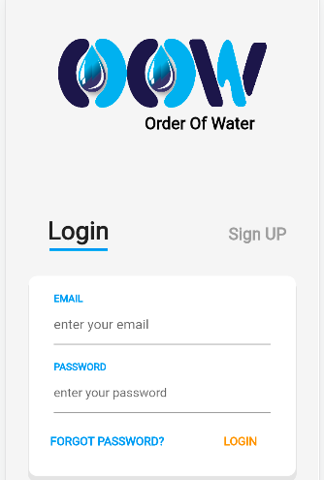
Front Page:

Slide 13
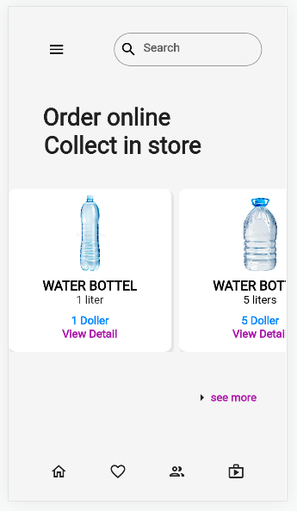
Home Page:

Slide 14
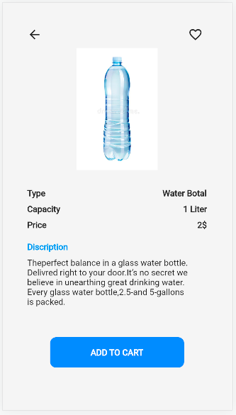
Product Detail Page:

Slide 15
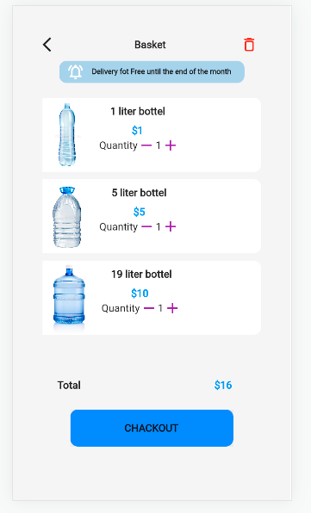
View Cart page:

Slide 16
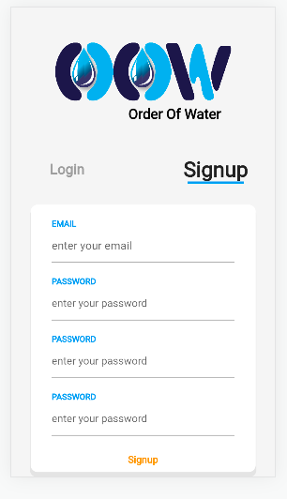
Customer Registration:

Slide 17
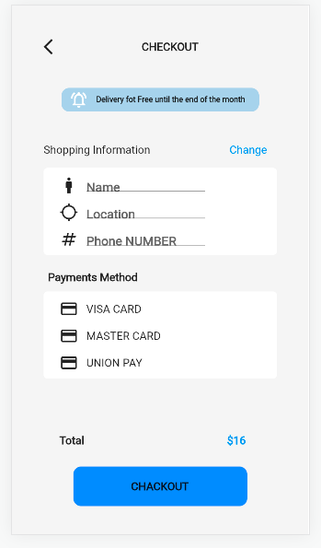
Payment Page:

Slide 18
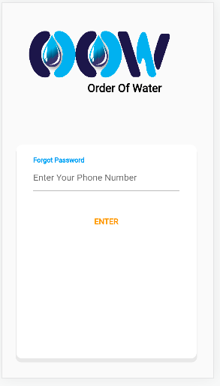
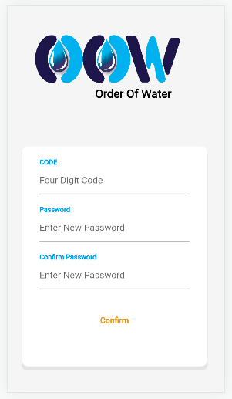
Forgot Page:

Slide 19


